Slide 1
Welcome to C programming for devices.
Week 1.

Slide 2
Convert following binary numbers to decimal and hexadecimal:
1100 0000
1111 0000
1010 1010
0011 0011

Slide 3
Convert to binary:
123
251
112
254

Slide 4
Convert to binary:
0xFE
0xAB
0x12
0x34

Slide 5
Types in C:
boolean (8 bit) - simple logical true/false
byte (8 bit) - unsigned number from 0-255
char (8 bit) - signed number from -128 to 127.
unsigned char (8 bit) - same as ‘byte’; Use ‘byte’ for reasons of clarity
word (16 bit) - unsigned number from 0-65535
unsigned int (16 bit)- the same as ‘word’. Use ‘word’ for clarity and brevity
int (16 bit) - signed number from -32768 to 32767.
unsigned long (32 bit) - unsigned number from 0-4,294,967,295.
long (32 bit) - signed number from -2,147,483,648 to 2,147,483,647
float (32 bit) - signed number from -3.4028235E38 to 3.4028235E38. Floating point on the Arduino is not native; the compiler has to jump through hoops to make it work. If you can avoid it, you should.

Slide 6
Defining a type in C:
#define testtype byte
testtype x=1;
testtype y=2;

Slide 7
Variables in C:
Declare:
int x;
int y;
Assign:
x = 1;
y = 1;
Declare and assign:
int z = 3;

Slide 8
Variables in C:
Global variables:
Declared out of any function
Working all over in the program
Local variables:
Working in the function where it is declared

Slide 9
A standard C program
Void main()
{
// The main function is always where the program starts
}

Slide 10
A Arduino C program
Void setup()
{
// this function runs first and only ones
}
Void loop()
{
// this is where your program is written
}

Slide 11
Control the program:
The if statement:
If (statement is true)
execute this line (otherwise dont)
Loops:
for – while – do while

Slide 12
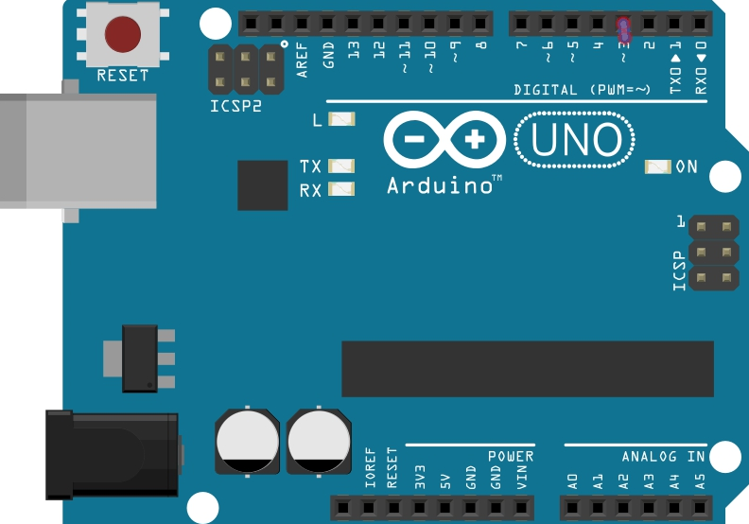
Arduino UNO:

Slide 13
Arduino:
Peripheral Features
– Two 8-bit Timer/Counters with Separate Prescaler and Compare Mode
– One 16-bit Timer/Counter with Separate Prescaler, Compare Mode, and Capture Mode
– Real Time Counter with Separate Oscillator
– Six PWM Channels
– 6-channel 10-bit ADC in PDIP Package
– One Programmable Serial USART
– One Byte-oriented 2-wire Serial Interface (Philips I2C compatible)

Slide 14
Arduino:
– One On-chip Analog Comparator
– Interrupt and Wake-up on Pin Change
• Special Microcontroller Features
– Power-on Reset and Programmable Brown-out Detection
– Internal Calibrated Oscillator
– External and Internal Interrupt Sources
– Six Sleep Modes: Idle, ADC Noise Reduction, Power-save, Power-down, Standby, and
Extended Standby
• I/O and Packages
– 23 Programmable I/O Lines

Slide 15
Digital output pin:
Digital output:
// Pin which controls the onboard led.
int LED = 13;
// Set the pinmode as output.
pinMode(LED, OUTPUT);
digitalWrite(LED,HIGH);

Slide 16
Digital input without pullup:
// Pin which controls INPUT on the L298N
int B = 4;
pinMode(B, INPUT);
if(digitalRead(B)==HIGH)

Slide 17
Digital input with pullup:
int B = 4;
// Set the pinmode as input.
pinMode(4, INPUT);
//activate built-in pull-up resistor.
digitalWrite(B, HIGH);
// or simply
// pinmode, and build-in pull-up.
pinMode(4, INPUT_PULLUP);

Slide 18
Analog input:
// Analog input pin from the potentiometer.
int analogInPin = A0;
sensorValue = analogRead(analogInPin);
// wait 2 milliseconds before the next loop
// for the analog-to-digital converter to settle
// after the last reading:

Slide 19
Analog output (PWM):
// Analog output pin where LED is attached to
int analogOutPin = 9;
anValue = analogRead(analogInPin);
outValue = map(anValue, 0, 1023, 0, 255);
analogWrite(analogOutPin, outValue);

Slide 20
Assignment 1
Make a program with following function.
By use of the delay function flash the LED connected to pin 13.

Slide 21
Assignment 2
Make a program with the following function
Connect a wire to an input port.
Turn the LED on.
by connecting the wire to ground.

Slide 22
Assignment 3
Connect the keypad 3x4 to input and output pins.
Make a program that decodes the keypad.
With a secret 4 digit code, turn the LED on and off

